Slide 1
Shopify templates
X.O.

Slide 2




Shopify templates
What you’ll need + lightweight tech stack
🛒
Your Shopify store + associated tenant in XO console
Shopify’s Liquid
Free carousel solution
Shopify uses its own templating language, it’s pretty easy to use! Find its documentation here.
This handy cheatsheet will get you started quickly.
Slick will make integrating a fully customizable slider a breeze.
Find its the documentation and check out all the options you can use here.
© 2020 Attraqt
2

Slide 3

Shopify templates
6 Steps to integrate your slider of XO recommendations
These are the 6 steps detailed in the new documentation
1/ Make sure you have jQuery installed in your chosen theme
2/ Create a div for your slick slider
3/ Add slick to your Shopify theme
4/ Add XO to your shop
5/ Get your recommendations
6/ Final touches
<div id=‘eb-container’></div>
✨
© 2020 Attraqt
3

Slide 4
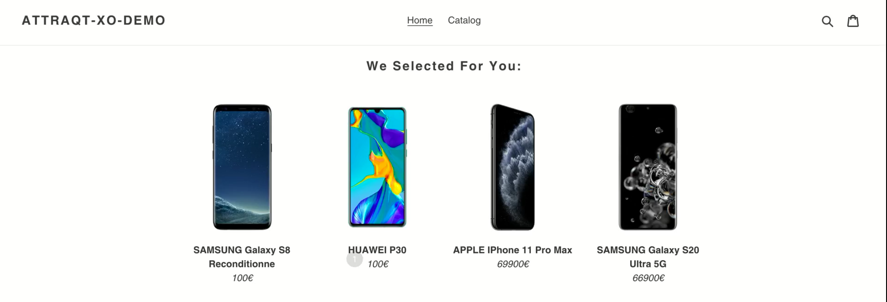
Shopify templates
Live Demo
Click to see it in action
Password: steegu
© 2020 Attraqt
4

Slide 5
Thank you!
6

